Slide 1

Research ethics
Research Skills
Advanced Diploma ICT
Dr Alveen Singh
Department of Information Technology
May 2022

Slide 2
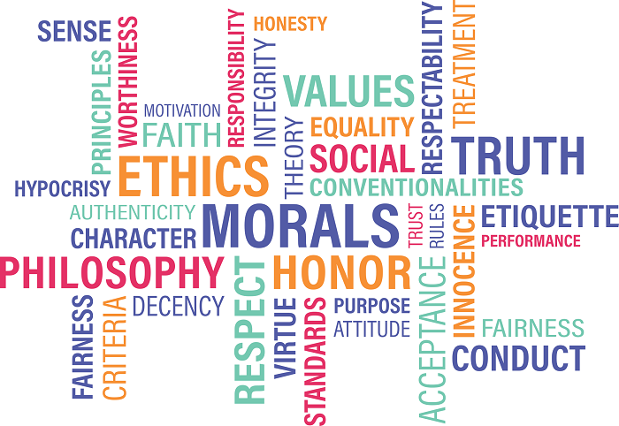
Content
1. Introduction
2. Rights of participants
2. Responsibility of the researcher
3. Plagiarism
Publications (predatory versus ISI and DHET)
The alternative: online data sources
Globethics.net, 2019

Slide 3
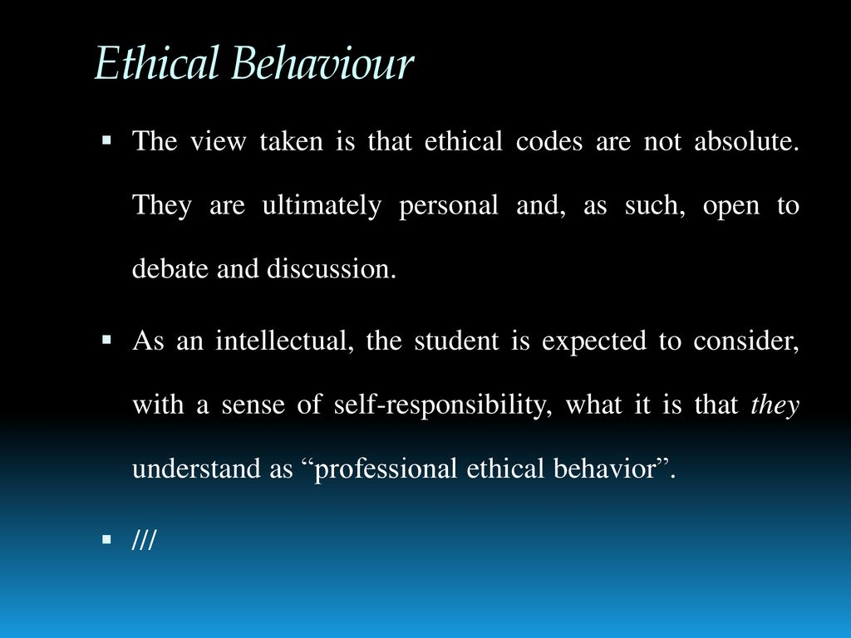
Järvinen, 2019

Slide 4
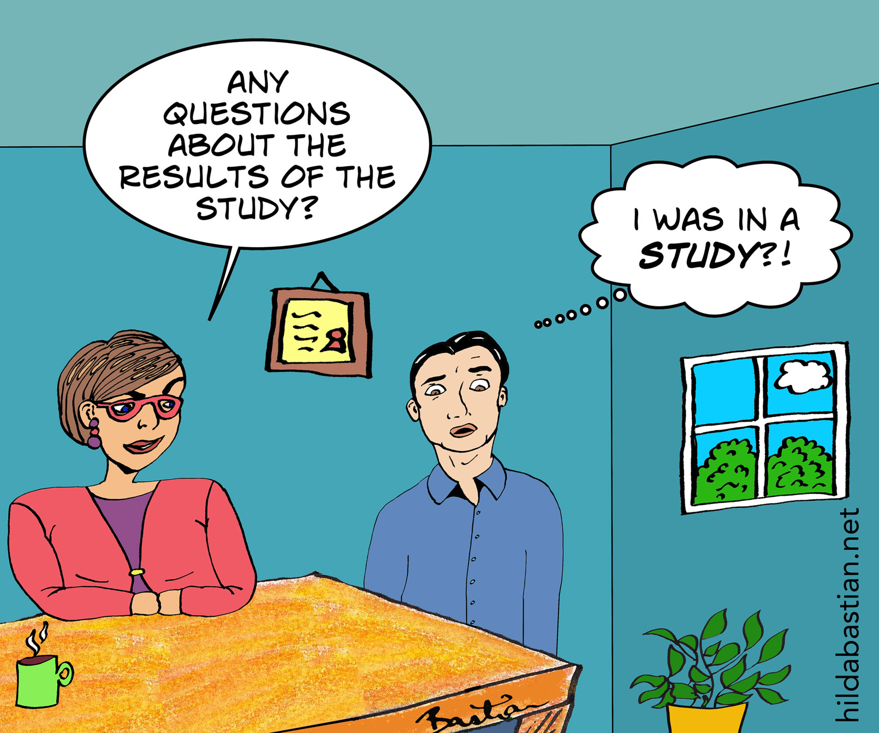
Introduction
Ethics is a crucial aspect of any research endeavor.
Research ethics is concerned with the treatment of people involved in the research, the way the work of others is acknowledged and the conduct research of research practices.
The researcher should always exhibit fairness, honesty and integrity.
Bastian, 2016

Slide 5
Universities require that researchers:
  explicitly state the ethical aspects of the research,
  provide a plan for ethical behaviour
  obtain ethical clearance before the research may begin.
DUT has the pg2a proposal template that contains a concise ethical clearance application.
  This is approved at Department, Faculty and Institutional level committees.
  https://www.dut.ac.za/research/institutional_research_ethics/

Slide 6

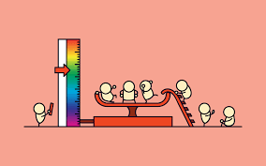
Rights of participants
Participants are those people directly involved or affected by the research.
These may include:
  participants being interviewed, questioned or observed (sometimes these are entire organizations and not just individuals)
  other researchers in the research project
  academic community who read, review and cite the research
  those that are directly impacted by the result of the research or its creations
cnn.com
Optimalworkshop.com

Slide 7
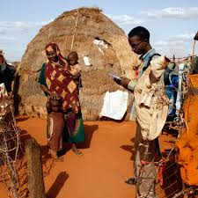
“Participants should not be used simply for the researcher’s own end”
They should not be manipulated, deceived,
blackmailed or coerced into participation
(for example consider the ethical circumstances when a software developer manager is conducting research in his/her place of employment).
theconversation.com

Slide 8

The right not to participate
The right to withdraw
The right to give informed consent
(i.e. their consent is given only when they are fully aware of their
involvement and the nature of the research)
The right to anonymity
The right to confidentiality (NDA signed with a participating company)
Oates, 2006

Slide 9
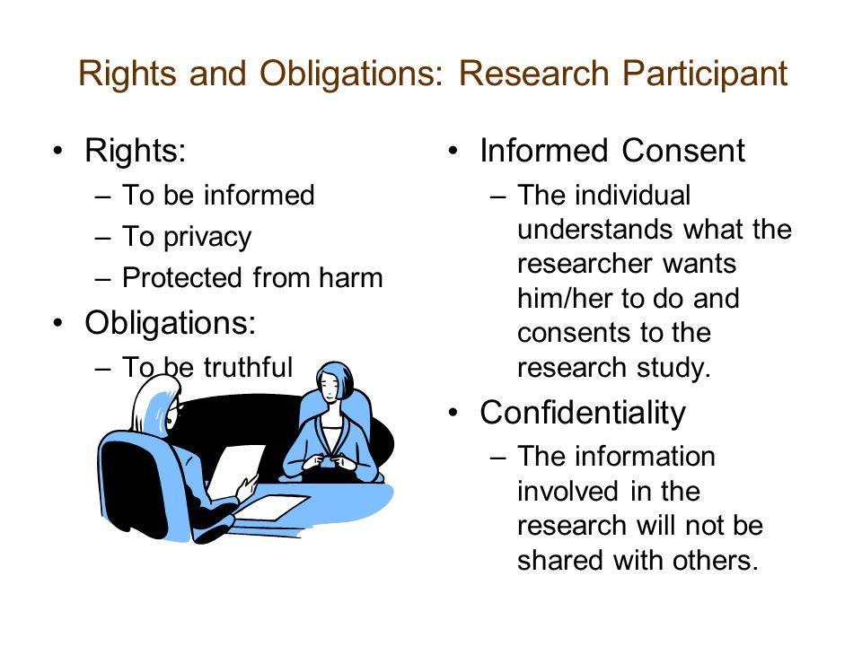
Washington, 2006

Slide 10
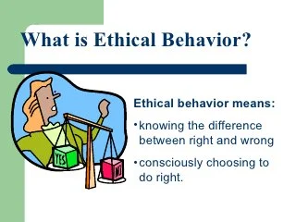
Ethical behaviour of the researcher
Good researchers strive to ensure that they uphold and become custodians of sound ethical behaviour.
The reputation of the researcher and the affiliate institution could be severely tarnished if research practice is otherwise.
Good practices from Oates (2006):
ncvps, small business, 2010

Slide 11
Intrusion
the researcher must be mindful of the type of data being collected.
  E.g. asking the respondent about salary.
Only necessary questions should be included and the researcher must be certain that the information that they are looking for is available and can be collected.

Slide 12
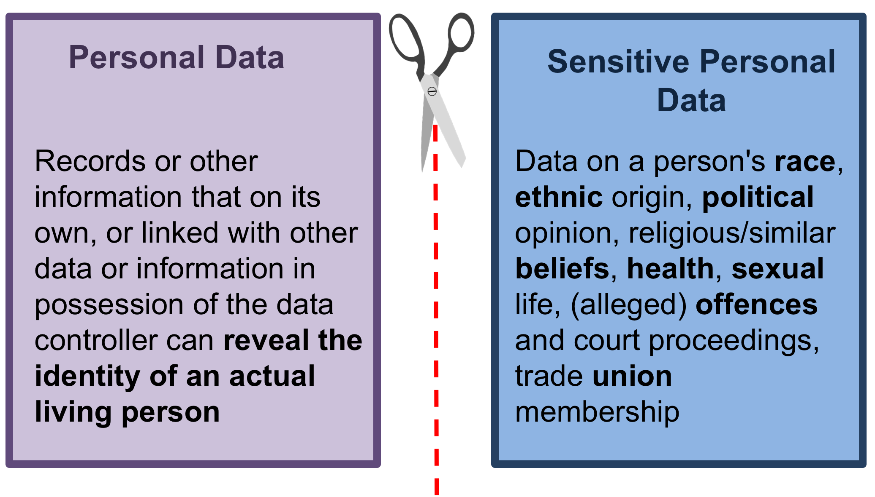
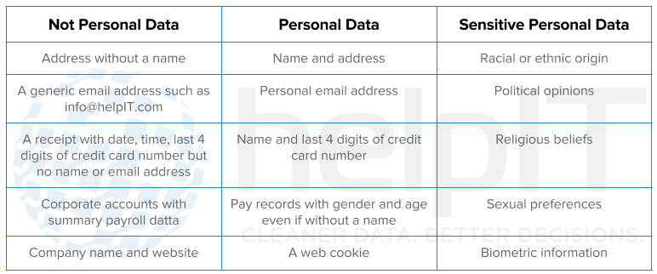
Gledisch, 2017
Swanborough, 2017

Slide 13
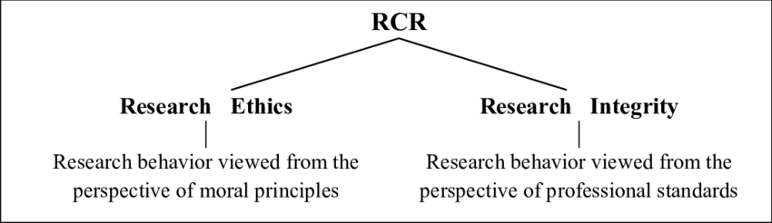
Integrity
The data being collected must be accurately reported and not manipulated or falsified to fit the research.
Data security and backup is the responsibility of the researcher.
Steneck, 2006

Slide 14
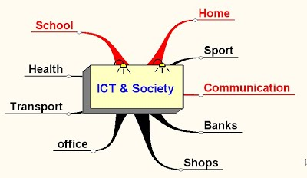
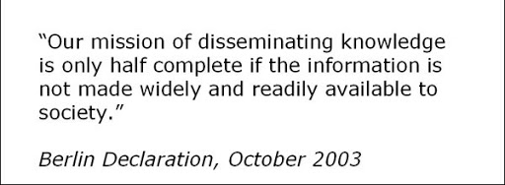
Feedback
Participants must be given a full debriefing and access to results post research.
This will allow them to benefit from the research
  Direct or indirect
The researcher should consider how the research findings will be used by society.
KS3Learning, 2010
Waaijers, 2007

Slide 15
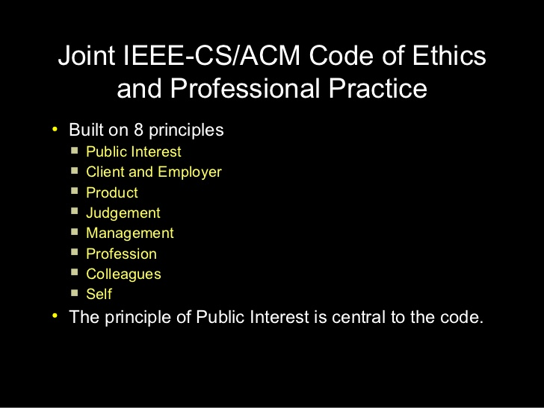

Adhere to professional bodies code of conduct
there are several professional bodies in IT
ACM and IEEE provide guidelines for professional conduct.
Ergin, 2012

Slide 16
Reviewing research work of others
maintain confidentiality of the content of the research being reviewed
Complete the review timeously
Provide eloquent criticisms and praise for the work

Slide 17
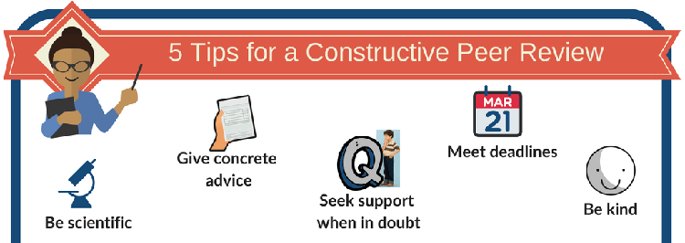
Enago academy, 2020

Slide 18
Ethical data analysis and publication
Fabrication of data
  making adjustments to data or filling in missing data.
Eliminating an outlier
  an outlier is data point very far or drastically different from the rest of the sample. This outlier may influence the results and lead to incorrect conclusions about the population. The researcher may eliminate the outlier but, this must be stated in the publication.
Exploitation of data
  occurs when researchers make undue claims or overemphasis the significance of a finding.
Lapan and Quartaroli, 2009

Slide 19
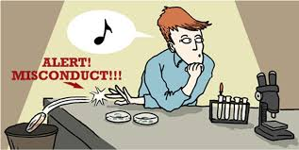
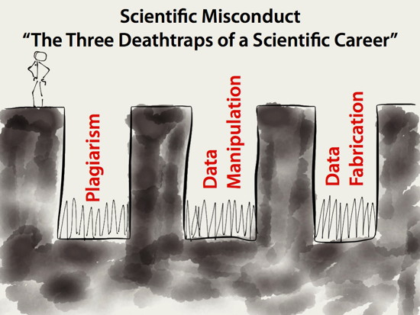
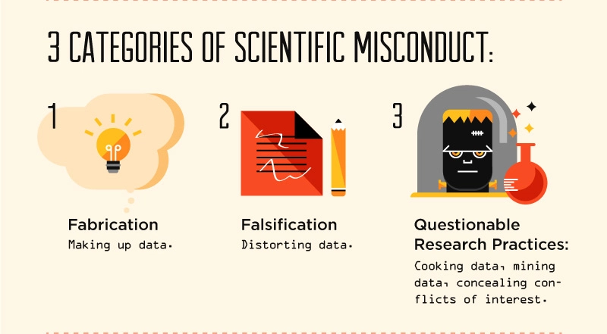
Riffat et Al
Wessel, 2020
St George Anaesthesia Education, 2020

Slide 20

Consequences of Scientific misconduct
Could mean the end to career as a researcher
Grounds for dismissal
Forfeiture of research grants
Blacklisted (e.g. reputable research organizations and universities refuse to hire; funding sources refuse to sponsor research work, journals refuse to consider any articles for publication)
Previously earned academic credentials taken away
Riffat et Al

Slide 21
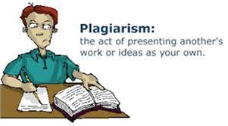
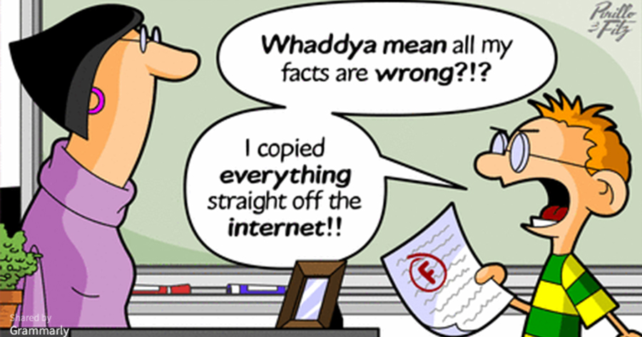
Plagiarism
Plagiarism is the act of copying the work of others and passing it of as the researcher’s own.
Plagiarism also includes the act of
copying the work of others
without correct referencing to acknowledge
the original authors.
Riffat et Al
Grammarly, 2015

Slide 22
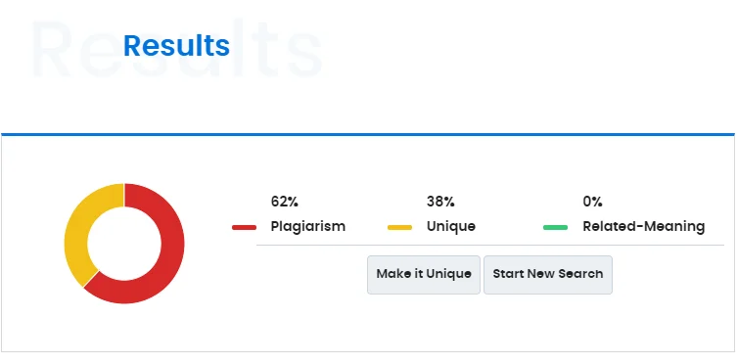
There are numerous software tools to assist in identifying plagiarism:
Turnitin,
Unicheck,
Plagscan,
Grammarly,
Plagramme,
Plagtracker,
Dupli Checker,
Copyleaks,
PaperRater,
Plagiarisma,
Plagium,
Quetext,
Viper
Duplichecker.com

Slide 23
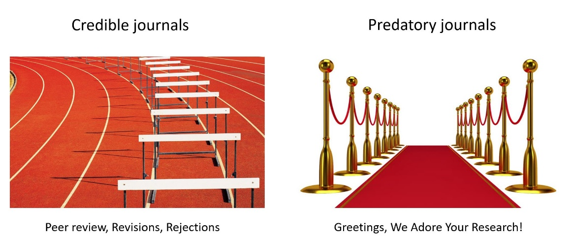
Publications (predatory versus accredited)
Predatory publishing is a business model that exploits researchers by charging them publication fees for publishing in a very poor quality journal.
Predatory journals often do not check the quality and legitimacy, lack a credible board of reviewers, do not have an editing service and publish poor quality research.
Hence, there are no funding awards nor credits for publishing in a predatory journal.
New scholars including students, are especially at risk of falling for predatory publishing.
Sax, 2020

Slide 24
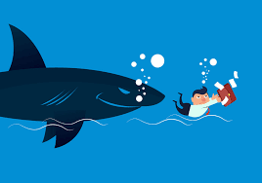
predatory journals engage in unfair and deceptive practices in the following ways
  Falsely claim rigorous peer review.
  Claim individuals as editors when those individuals never agreed to become editors.
  Send solicitations to potential authors on behalf of other academics, without permission from those academics.
  Give their journals a nearly identical name as another respected journal.
  Fail to disclose publication fees until after authors submit articles, and demand payment to withdraw the article.
  Misrepresent the Impact Factor of their journals.
  Falsely claim that their journals are included in academic indexes such as, the ISI.
  Falsely claim that respected individuals will participate in conferences to increase attendance
  Anderson (2017)
Getty images

Slide 25
University libraries maintain a list of accredited publishers.
  And a list of predatory publishers see, Cabells database
Students and researchers must consult these lists before committing to a publisher.

Slide 26




In contrast, accredited publishers maintain high quality and standards in academic publications.
Researchers often receive credit and acclaim from publishing in these ranked journals.

